Slide 1
LA solution
----STEM curriculum design learning and practice tools
（STEM课程设计学习与操练工具）
Group4：Yu Xiaoxue, Li Jiaxuan, Yu Qing, Liu Yunmeng, Zhou Yumeng

Slide 2
Content
Web page
Purpose
Learning experience
Learning analytics
Analyze online learning behavior
Analyze path of instructional design
Assessment of STEM course

Slide 3
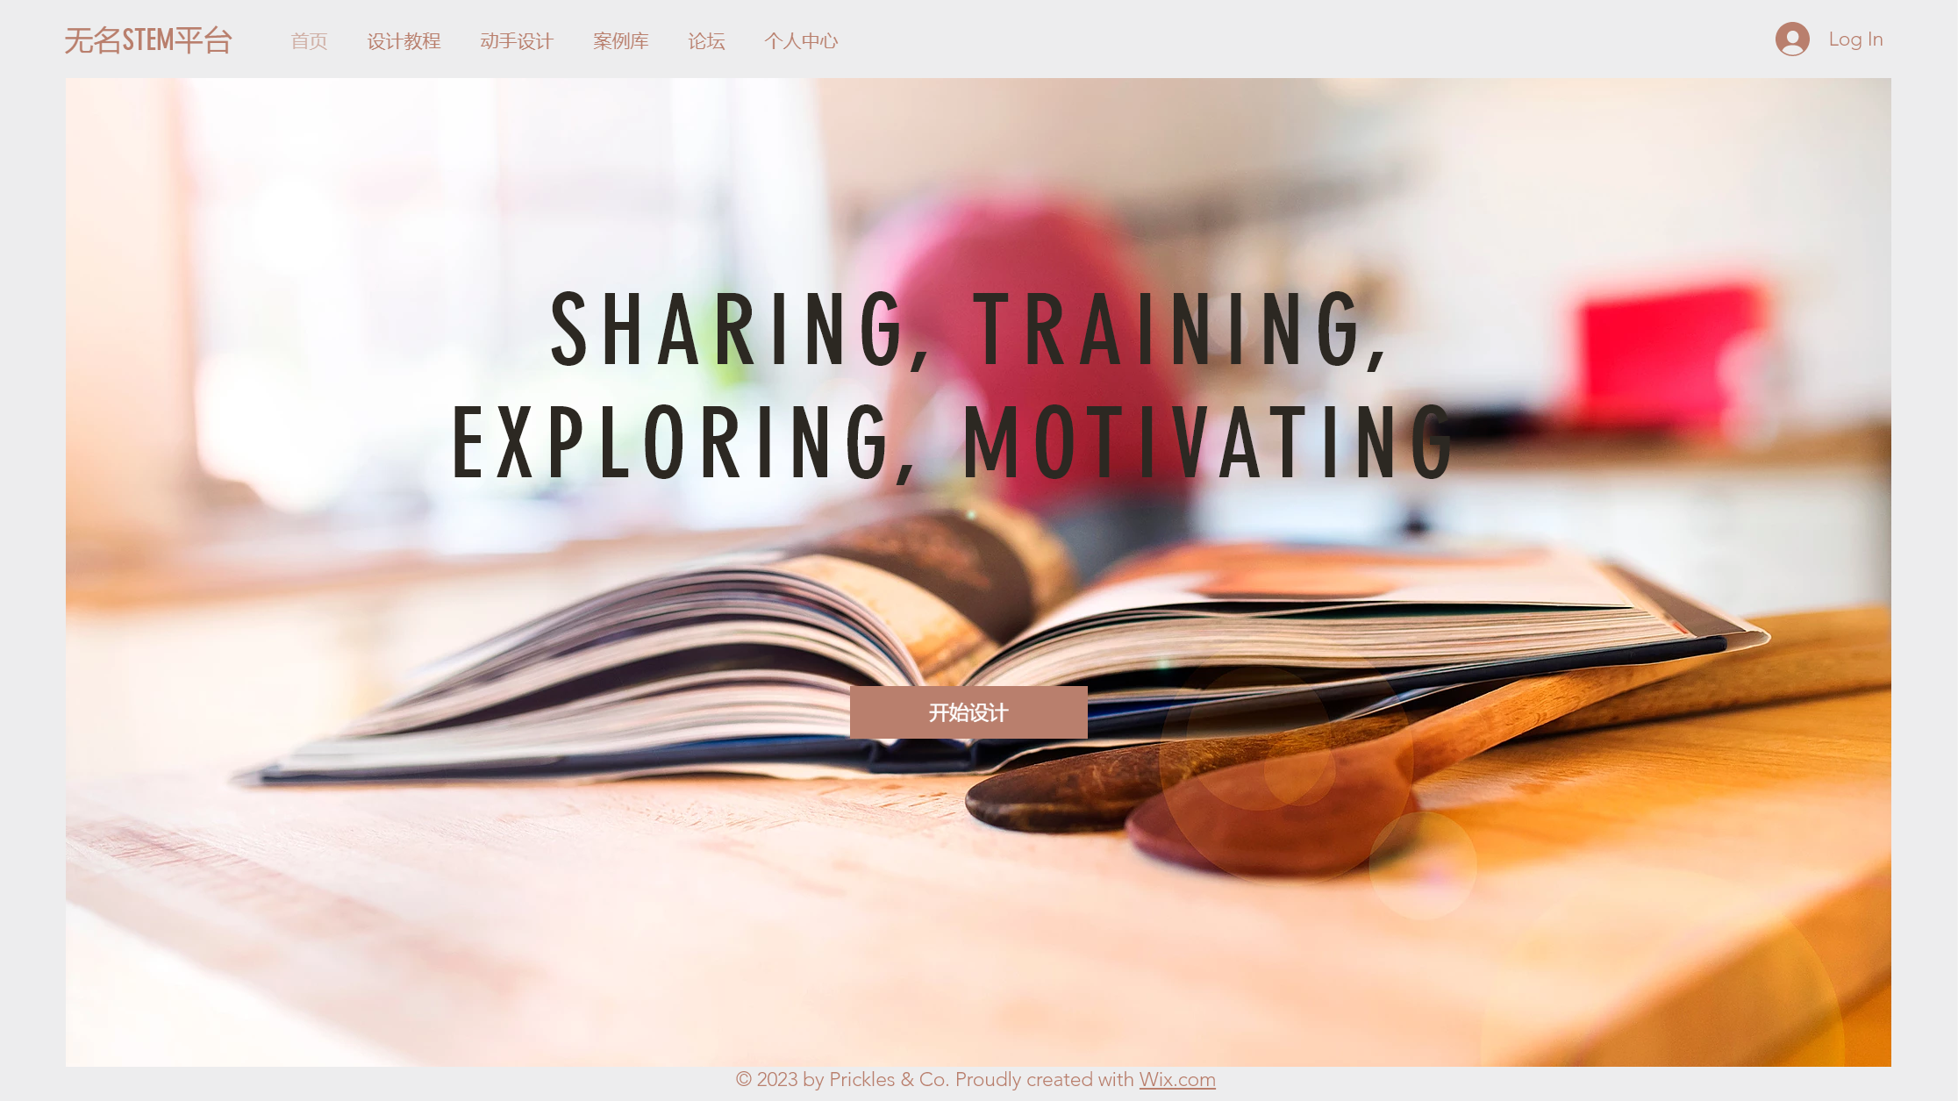
Tutorial/design/case/discussion/personal center
homepage

Slide 4
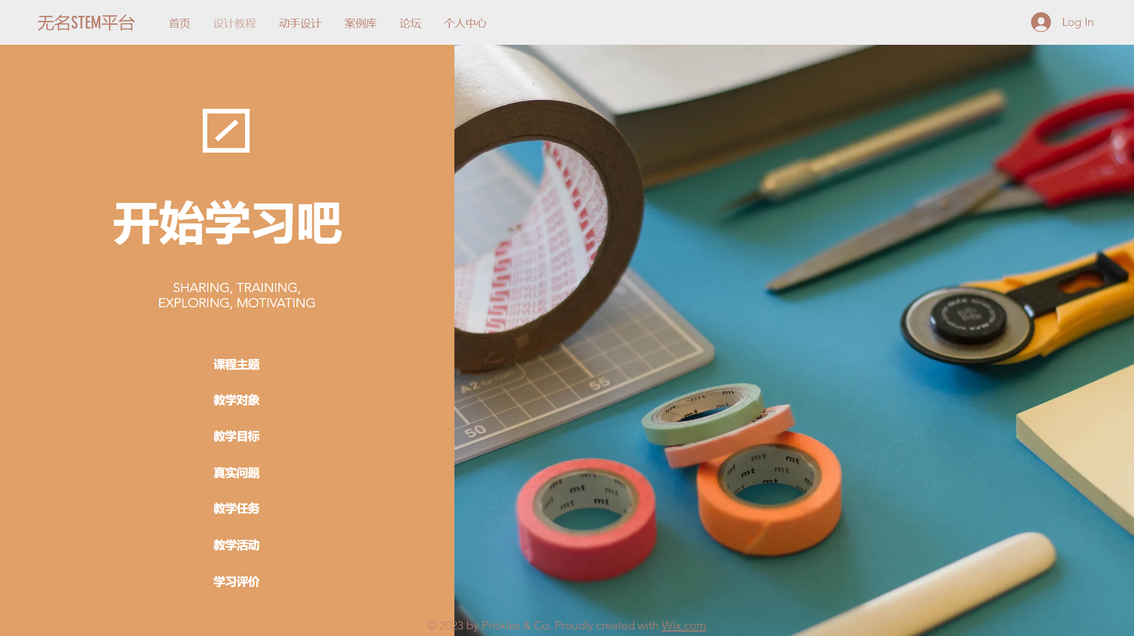
tutorial

Slide 5
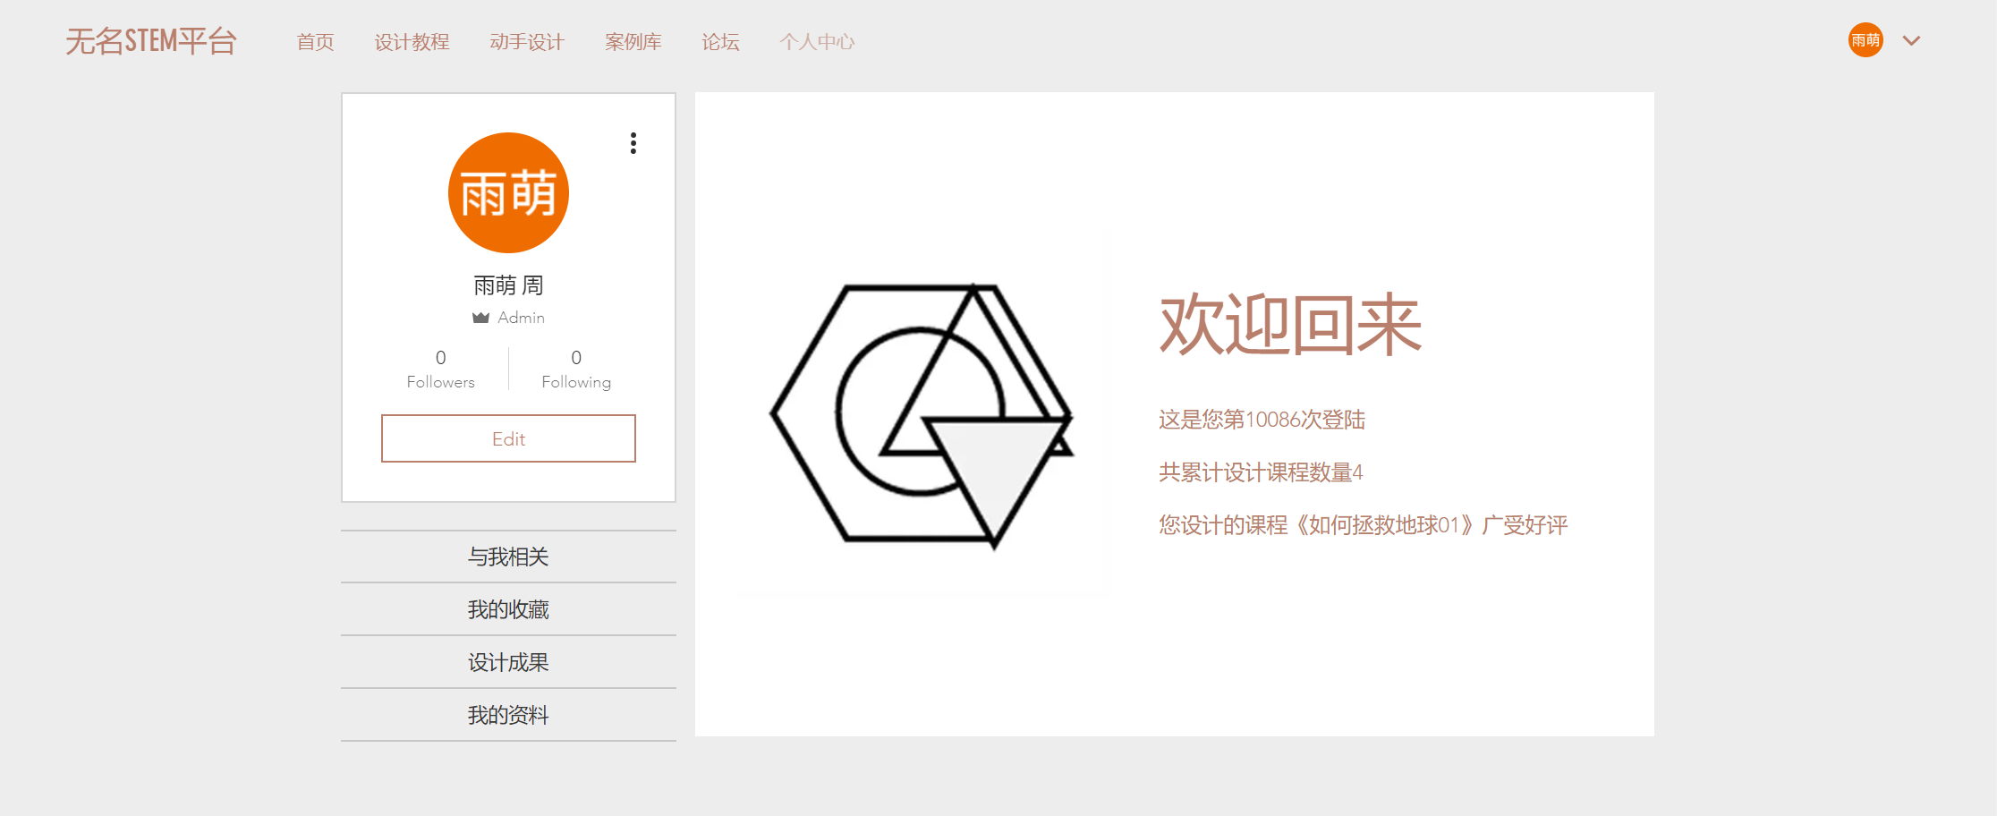
Personal center

Slide 6
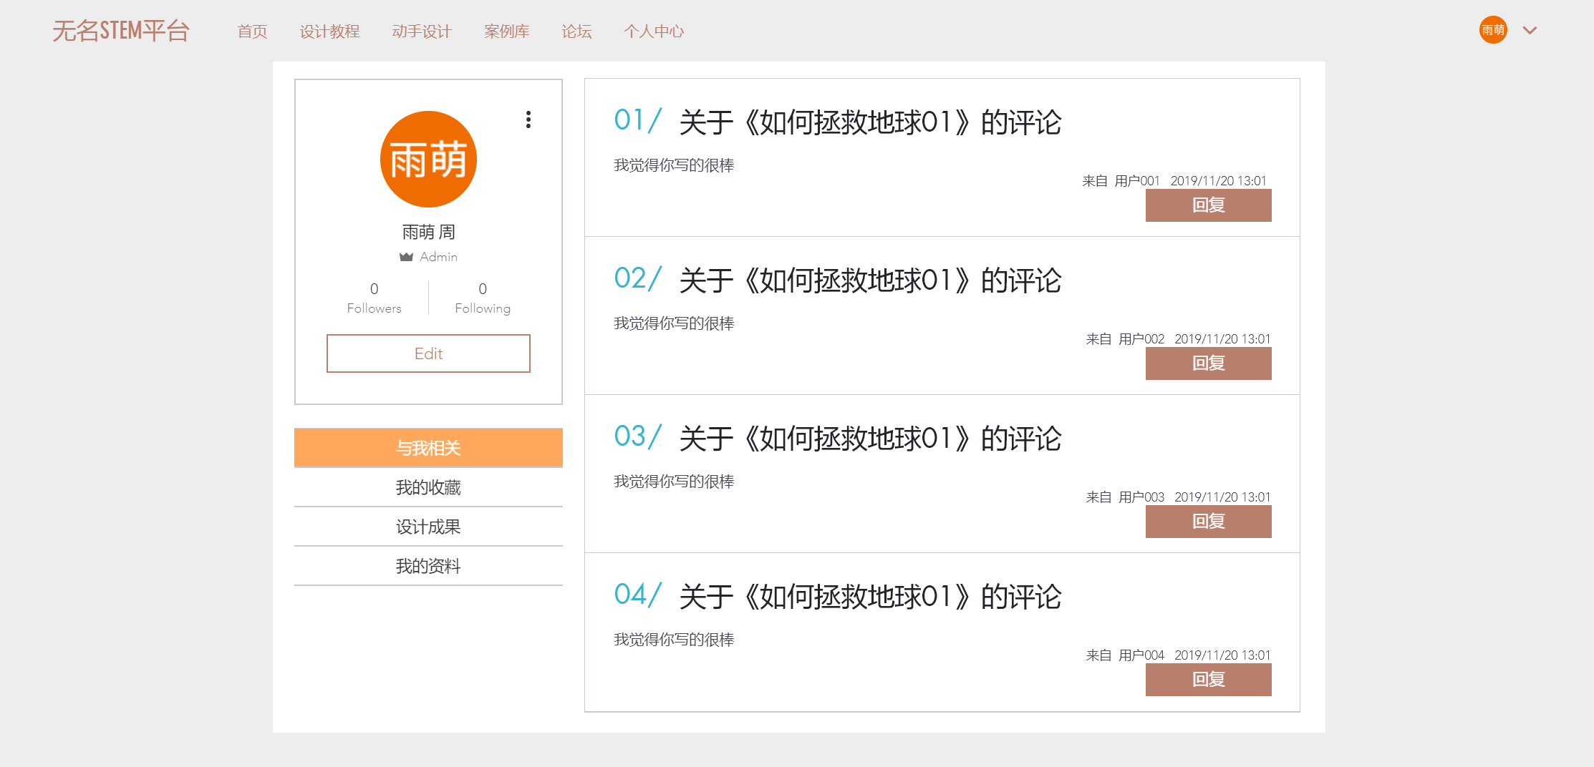
Personal center
-related to me

Slide 7
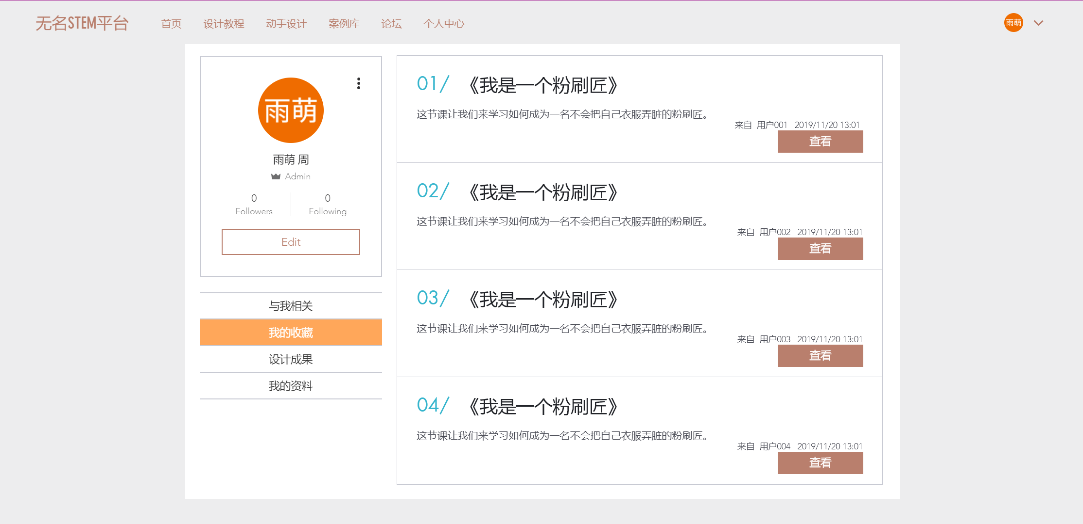
Personal center
-my favorite

Slide 8
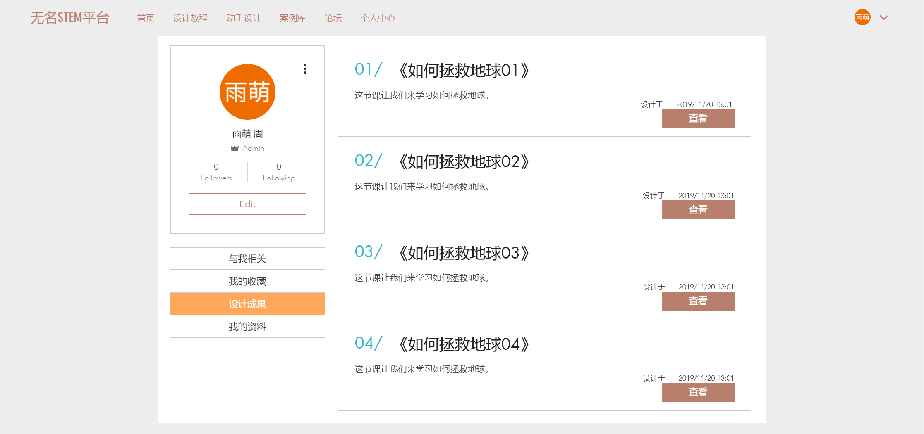
Personal center
-design results

Slide 9
Purpose
Learn how to design STEM course
Design STEM course
Communicate and improve ability

Slide 10
Learning experience-through platform function
Function | Content | Learning experience
Tutorial（教程） | theories, frameworks, principles and methods for designing stem courses | have a general understanding of how to design stem courses and achieve self-directed learning
Design （动手设计） | a form to fill in the teaching plan of stem courses, which can be downloaded and shared by the team or individual | realize collaborative learning and stimulate learning motivation
Case（案例库） | demonstrate excellent stem cases for learners' reference and communication | enrich learners' cognition of stem courses, and inspire new ideas
Discussion （论坛） | instant and effective reply communication on the interaction between learners & the interaction between learners and experts | can help learners solve problems, eliminate loneliness and stimulate learning motivation
Personal center （个人中心） | demonstrate personal design, interaction and evaluation, including your own work, thumb up, sharing and comments, | create a personal space for the learning community, and enhance self-efficacy
江毓君,白雪梅,伍文臣,罗晓娟.在线学习体验影响因素结构关系探析[J].现代远距离教育,2019(01):27-36.

Slide 11
Learning analytics
Online learning
behavior
Path of instructional
design
STEM course
designed
Framework of learning analytics

Slide 12
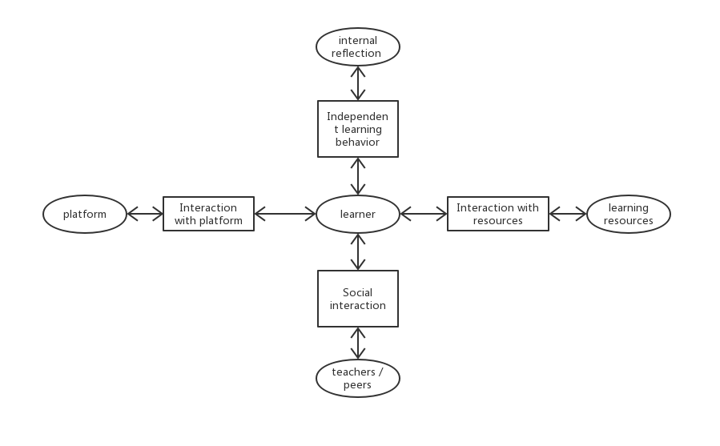
Analyze online learning behavior
Online learning behavior
Online learning space
Learning path
Structure of online learning space

Slide 13
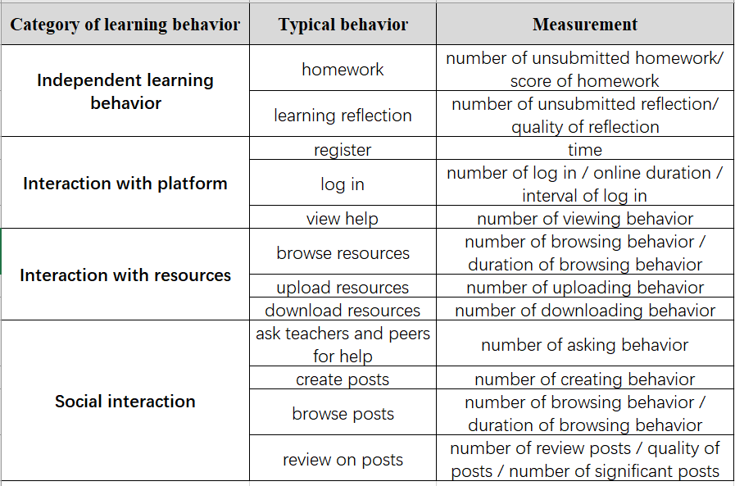
Analyze online learning behavior
吴林静,劳传媛,刘清堂,程云,毛刚.网络学习空间中的在线学习行为分析模型及应用研究[J].现代教育技术,2018,28(06):46-53.

Slide 14
Analyze online learning behavior
method
result
stakeholder
purpose
Correlation
Identify core indicators
Manager
Policy making
Classify
Prediction
Teacher
Teaching intervention
Cluster
Mode
Learner
Self-correction
Model of learning analytics

Slide 15

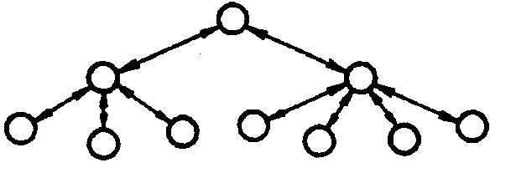
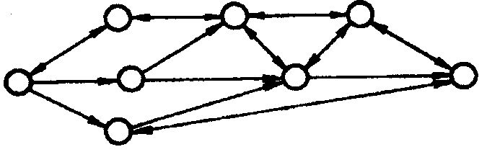
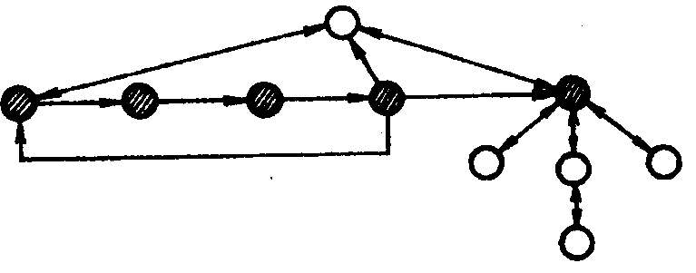
Analyze path of instructional design
Line-like
Tree-like
Measurement:
Who + When + What (behavior)
Net-like
Mixed

Slide 16
Assessment of STEM course
Dimension of STEM course
Learning goal
Expert assessment
Instructional strategies
Tasks, activities, materials
Peer assessment
Learning assessment

